Slide 1
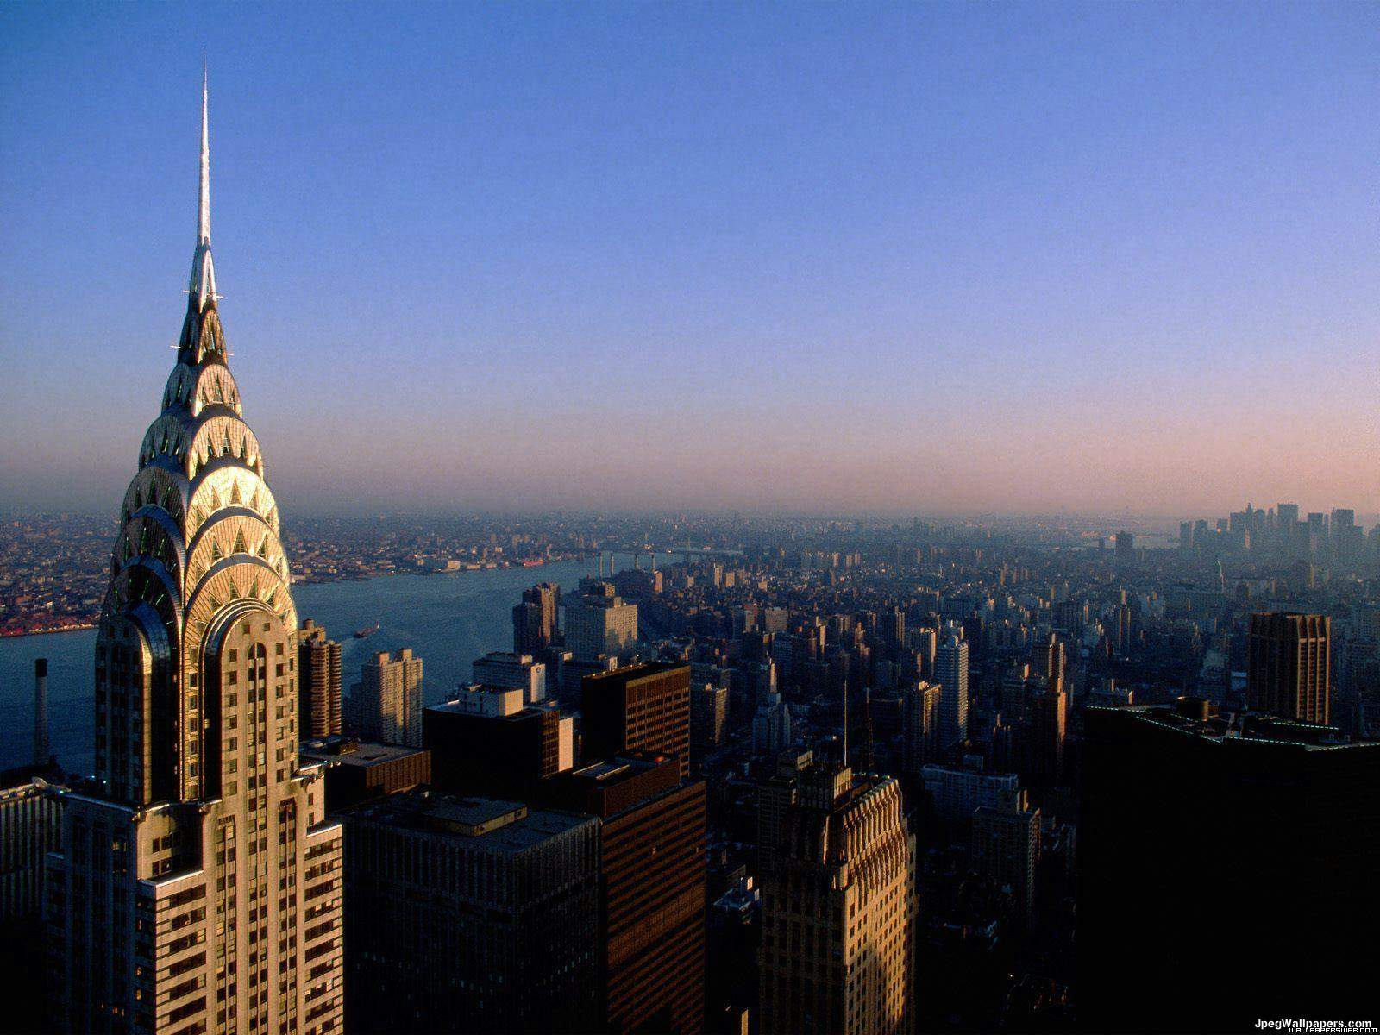
Skyscrapers
JT Wunderlich PhD

Slide 2
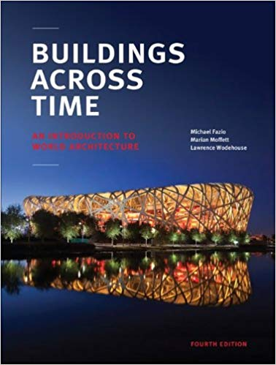
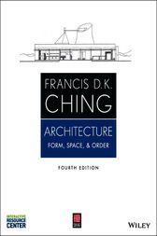
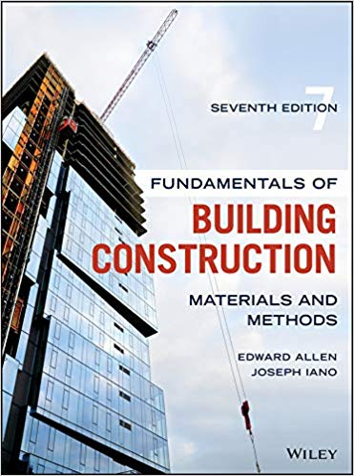
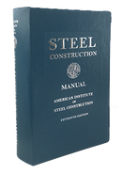
Primary Sources
[1] Fazio, Michael and Moffett, Marian. Buildings Across Time. Lawrence
Wodehouse, 4th Edition, McGraw Hill, 2013.
[2] Ching, Francis D.K. Architecture: Form, Space, and Order. 4 ed.
Wiley, 2014.
[3] Allan, Edward and Iana, Joseph, Fundamentals of Building Construction: Materials and Methods. Wiley; 7thedition (October 15, 2019).
[4] AISC, Steel Construction Manual, 15th Edition, 2017.
Personal Architecture projects in Texas, California, and Pennsylvania
BS Architectural Engineering (U.Texas 84)
1-1/2 years of Urban Design (UCSD 1986-87)
Education and experience for past 40 years applicable towards licensing as both a Professional Engineer and a Registered Architect
Frequent international travel pictures of Architecture and Urban Design

Slide 3
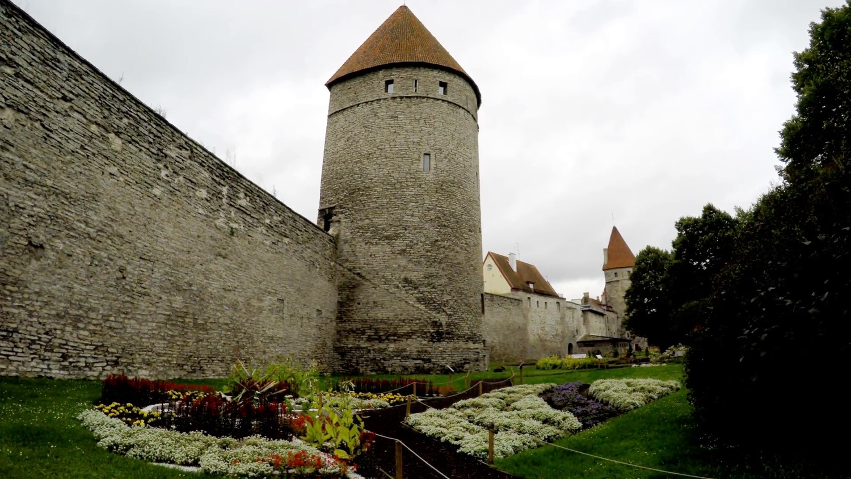
A skyscraper is a Tower
During Feudal times (e.g. Europe or Japan), towers protected cities and castles, and demonstrated status of feudal Lords and Kings
ESTONIA https://www.videoblocks.com/video/medieval-towers---part-of-city-wall-tallinn-estonia-nhxkbvipg

Slide 4
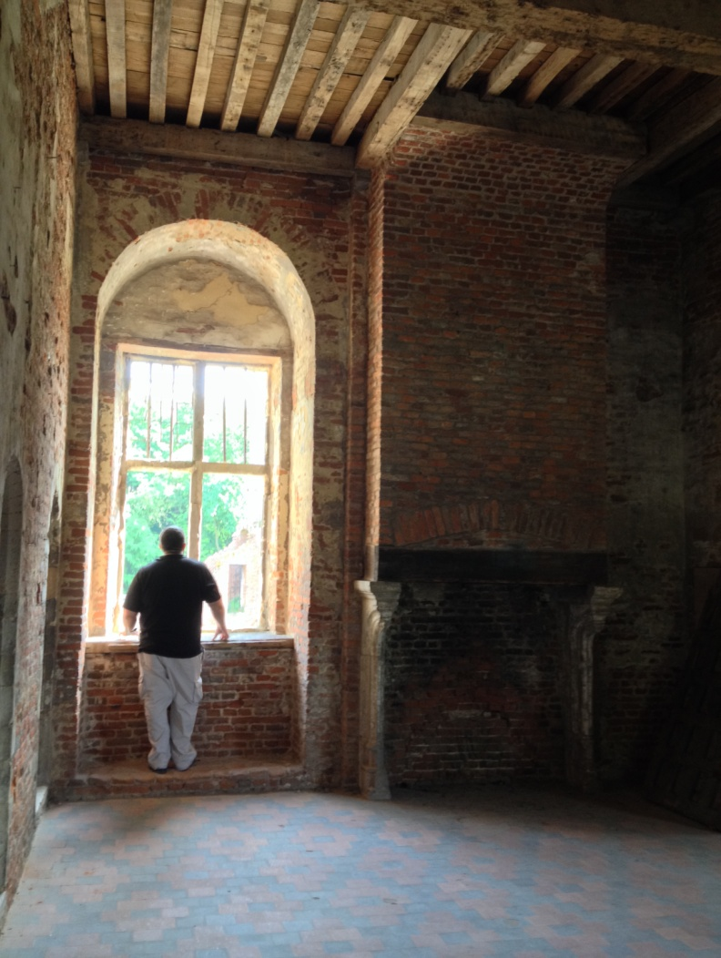
WALL PLANE
Belgium 2014
Kasteel Beersel, Belgium

Slide 5
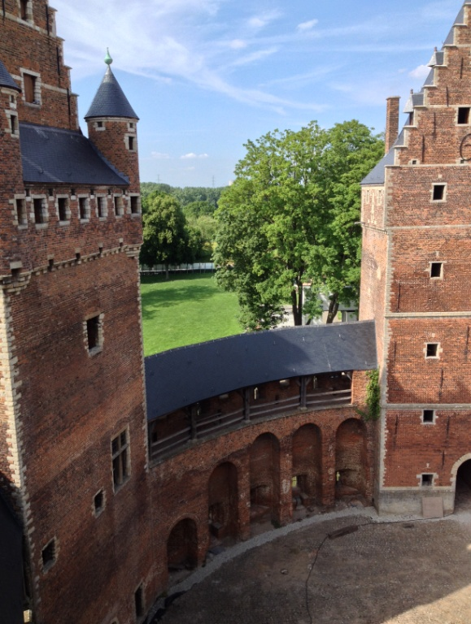
Belgium 2014
WALL PLANE
Belgium 2014
Kasteel Beersel, Belgium

Slide 6
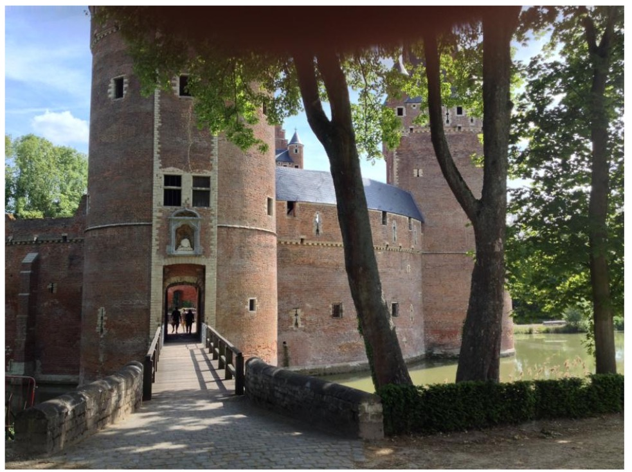
Belgium 2014
Kasteel Beersel, Belgium

Slide 7
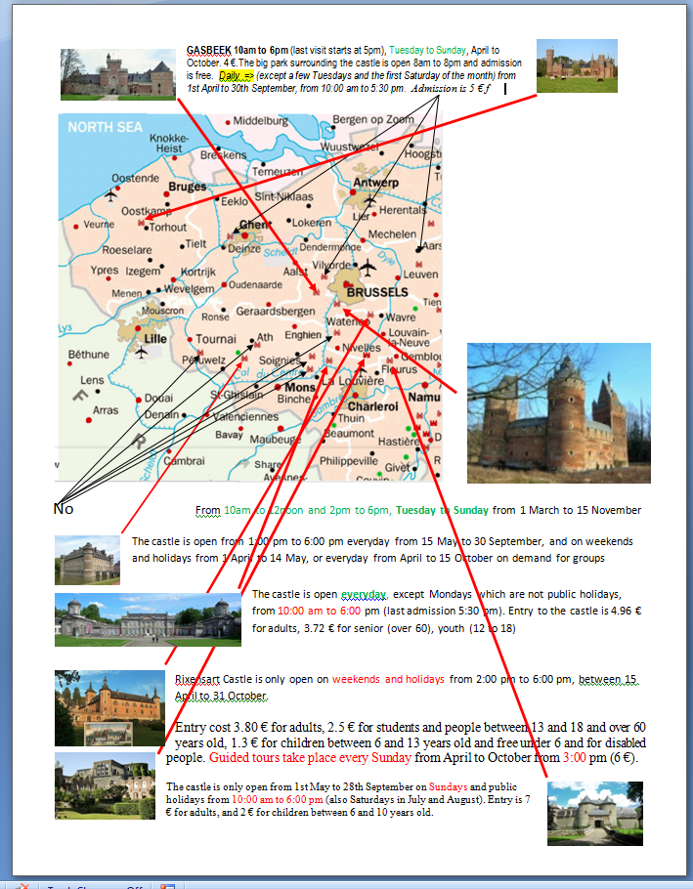
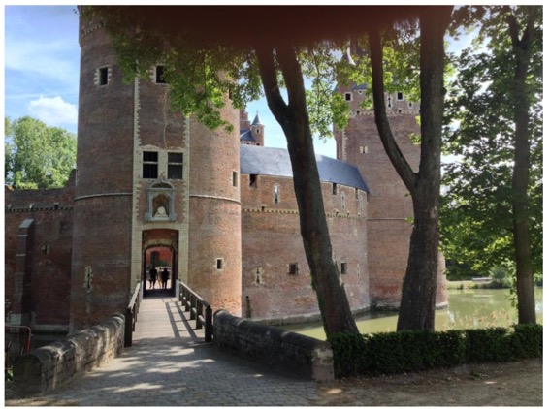
Belgium 2014
Selecting a castle to visit on 2014 Belgium/Italy/England trip
Kasteel Beersel, Belgium

Slide 8
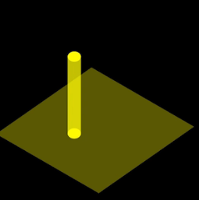
DEFINING SPACE
“A obelisk or tower establishes a point on the ground and makes it visible in space
… a column generates a field about itself and interacts with the space” [2]

Slide 9
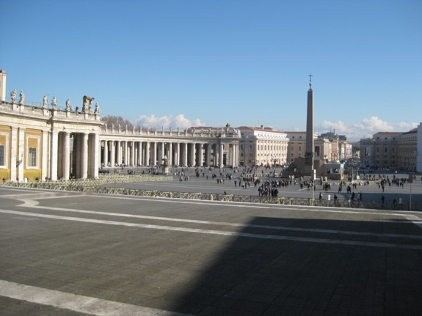
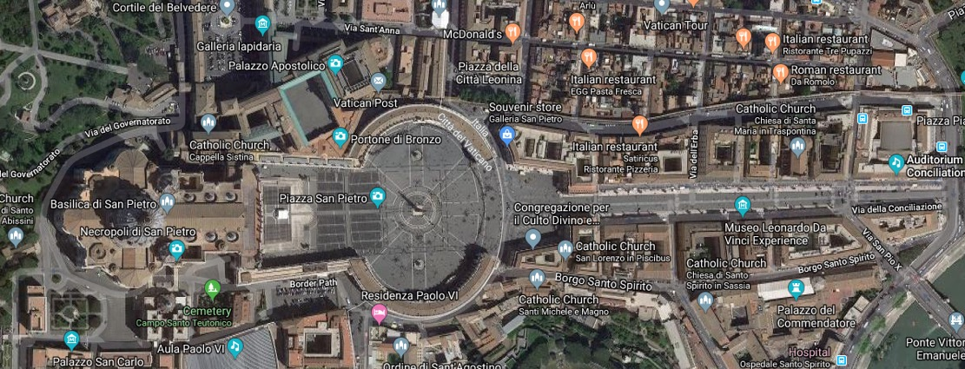
“At the center of its environment, a point is stable and at rest, organizing surrounding elements about itself and dominating its field” [2]
Rome, 2011
Piazza San Pietro, Vatican City, Rome

Slide 10
Rome 2011

Slide 11
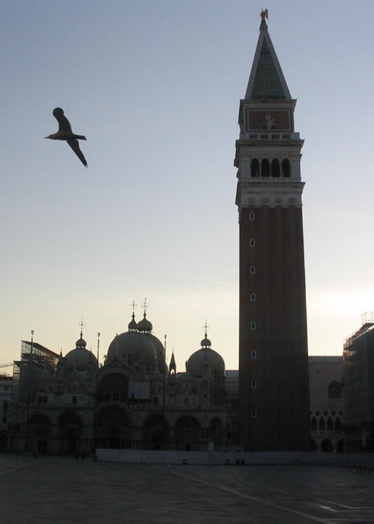
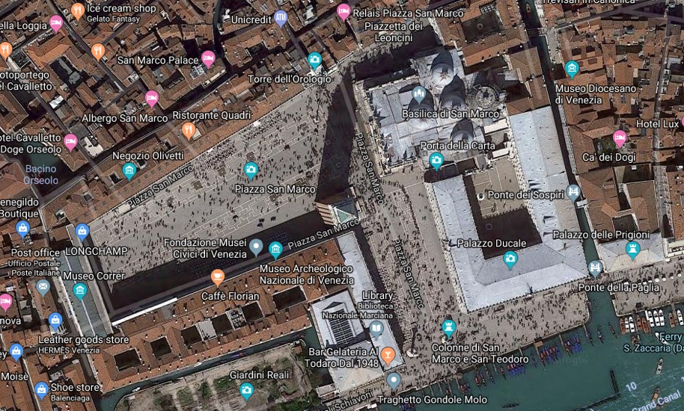
‘When moved off center, it's field becomes more aggressive and begins to compete for visual supremacy. Visual tension is created between the point and it's field” [2]
Venice 2008,2011,2014,2017
Campanile di San Marco in Piazza San Marco, Venice

Slide 12
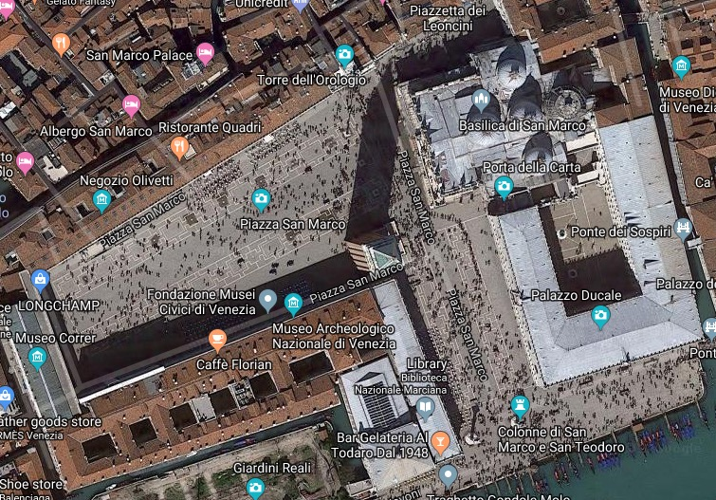
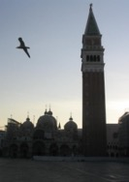
POINT off-center -- >Visual Tension
Venice 2008,2011,2014,2017
Campanile di San Marco

Slide 13
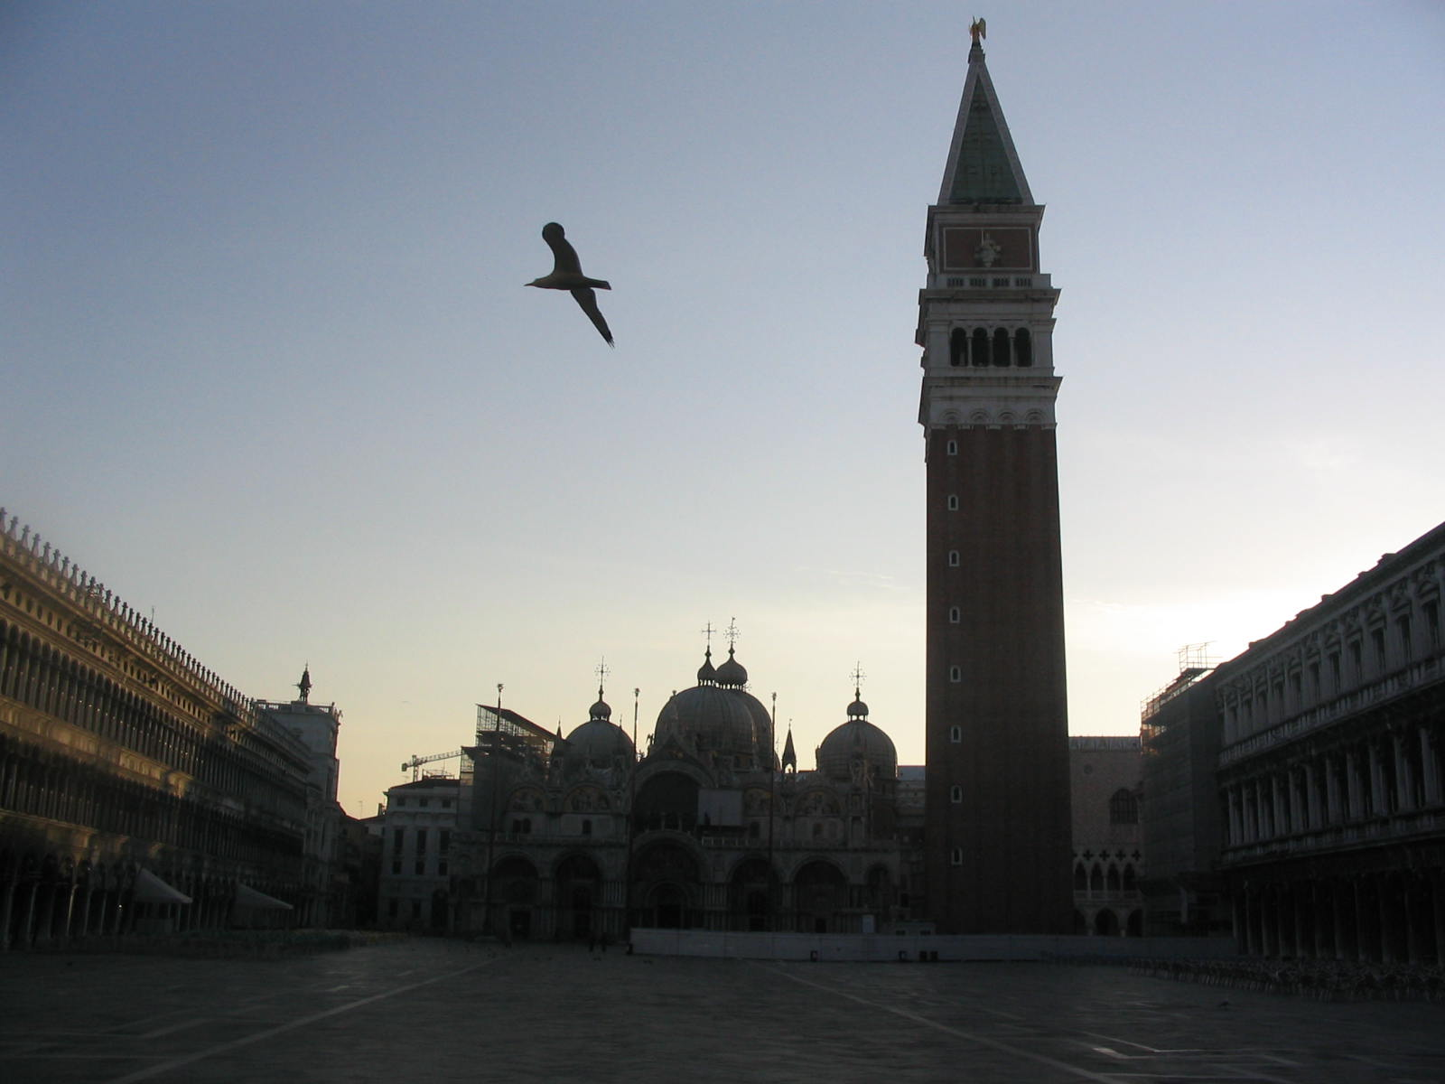

Slide 14
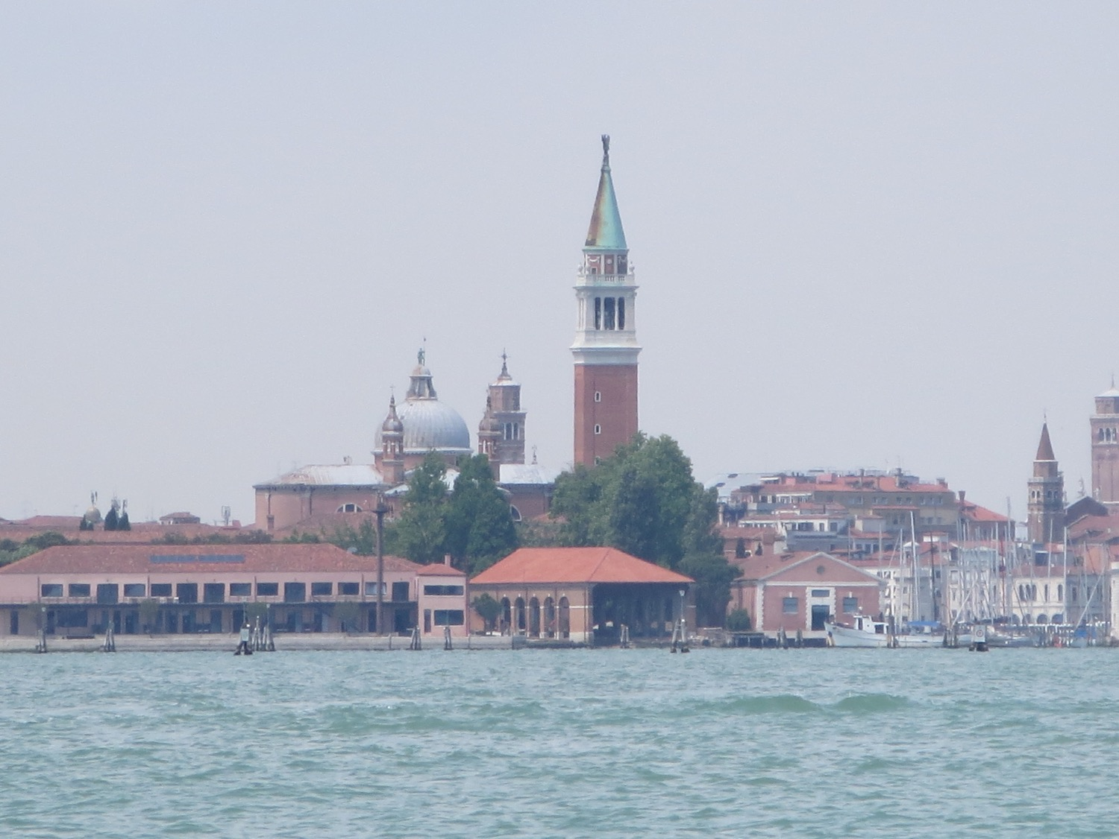
Venice 2008,2011,2014,2017

Slide 15
“A vertical line can express a state of equilibrium with gravity, and symbolize the human condition” [2]

Slide 16
“vertical equilibrium …the human condition” [2]

Slide 17
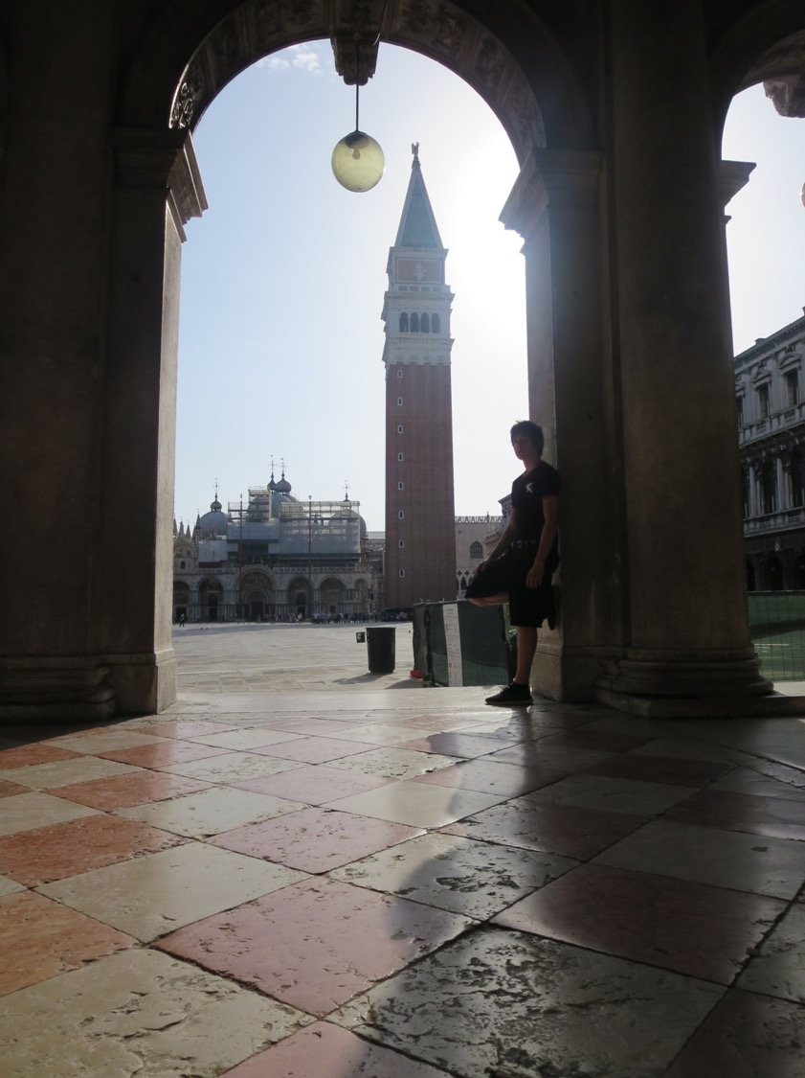
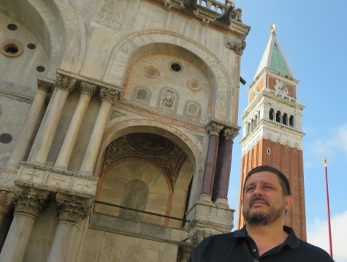
Venice 2008,2011,2014,2017

Slide 18
Prior to 1800’s, most buildings not very tall, and mostly made of wood, or unreinforced masonry or concrete

Slide 19
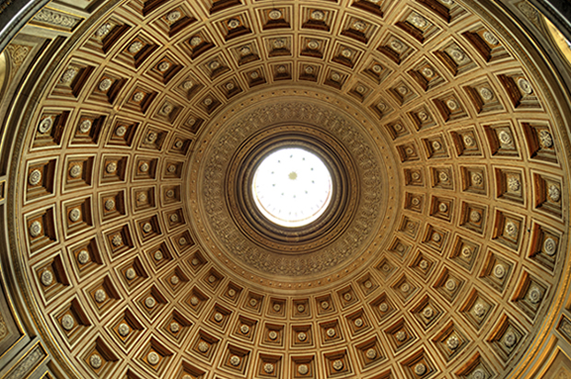
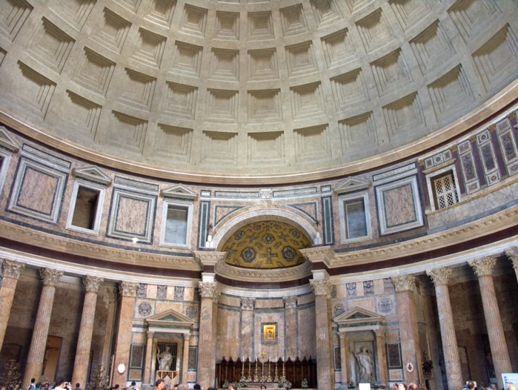
UNREINFORCED CONCRETE
UNREINFORCED CONCRETE
Concrete is a “concretion” of a mix of AGGREGATE (rocks) and a cementations binding material (CEMENT)
- Romans used it extensively from 300BC to 475AD
http://thumbs.media.smithsonianmag.com//filer/Roman-cement-
http://upload.wikimedia.org/wikipedia/commons/5/51/Rome-Pantheon-Interieur1.jpg

Slide 20
Early 1800’s in the U.S.
First cast-iron frames and building fronts
(often painted to look like stone or other materials)
1865+ in the U.S.
Industrial revolution – mass production
Tall buildings a result of rising urban real estate values, and desire of businesses to remain in center of activity

Slide 21
STEEL
Cast IRON
Alloy of iron, carbon, and silicon cast in a mold; and is Hard, Brittle, Nonmalleable”
Wrought IRON
A form of iron; Tough, Malleable, relatively soft, contains usually less than 0.1 percent carbon, and 1 or 2 percent slag (stony waste matter separated from metals during the smelting or refining of ore)
STEEL
Commercial iron with varying degrees of carbon content yields different strengths for structural steel building skeletons. Also more malleability than cast iron… i.e., less brittle (more ”Ductile”). Structural engineers want to specify for both strength and ductility.
SOURCE: http://www.merriam-webster.com/dictionary/

Slide 22
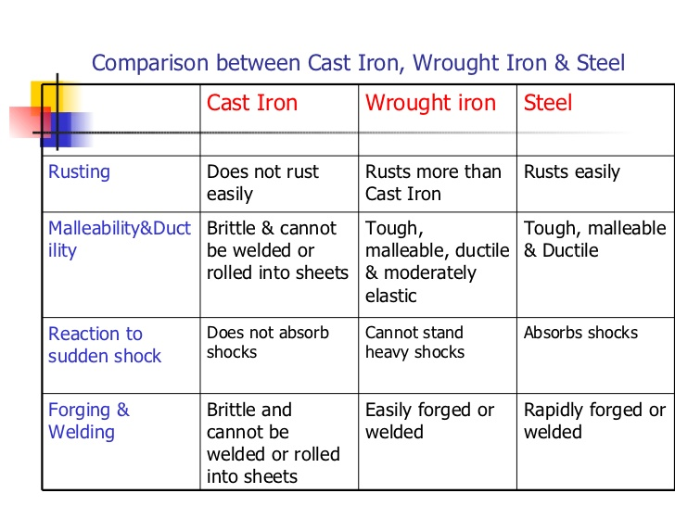
STEEL
From http://image.slidesharecdn.com/structural-steel-8768/95/structural-steel-6-728.jpg?cb=1173466999

Slide 23
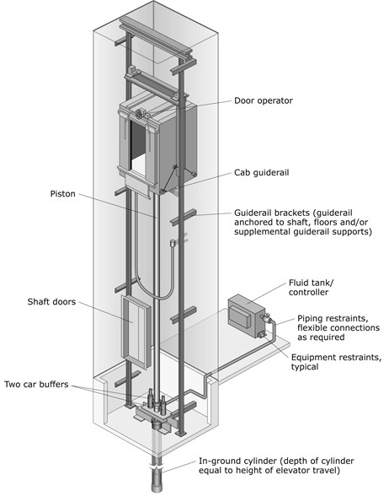
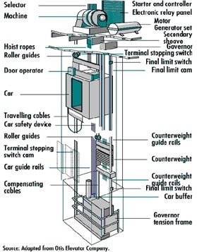
ELEVATOR’s
The ELEVATOR helped facilitate taller buildings
Modern High-speed electric motors elevators for tall buildings
Modern Hydraulic elevators for shorter buildings:
http://www.fema.gov/sites/default/files/orig/plan/prevent/earthquake/fema74/images/chapter6_4_10/fig1_1.jpg
http://www.featurepics.com/FI/Thumb300/20070505/Highrise-Construction-306455.jpg

Slide 24
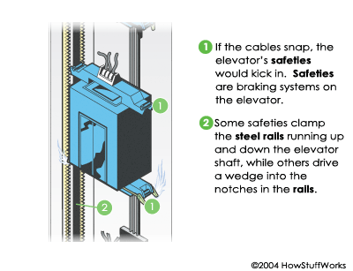
Elevator SAFETY-SYSTEMS allowed even taller buildings
ELEVATOR’s Today
Modern Braking system stops elevator from free-fall if cable snaps or melts
Also, buffers at bottoms of shafts to dampen a falling elevator
http://static.ddmcdn.com/gif/runaway-elevator-2.gif

Slide 25
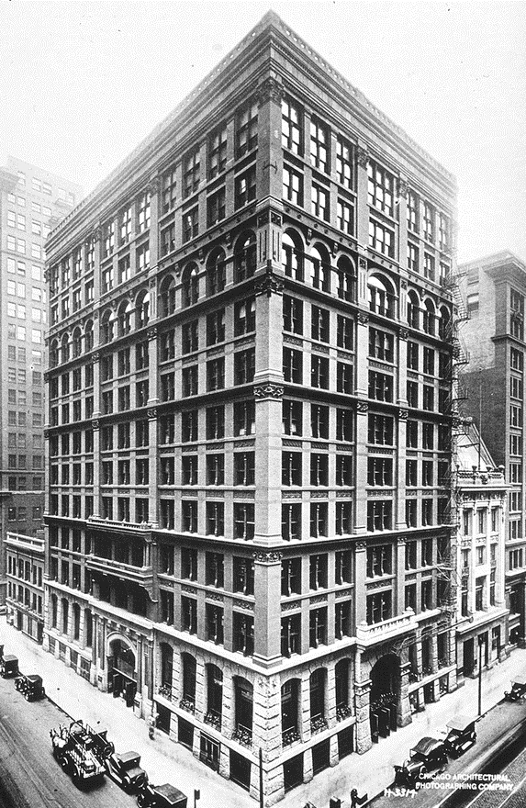
William Le Baron Jenny Home Insurance Building Chicago 1883 Demolished 1931
1883 STEEL
and an elevator
First “Steel Skeleton”
– but also much cast iron, and the first floor had masonry load-bearing walls [1]
Also one of the first skyscrapers to use an elevator (hydraulic)
https://en.wikipedia.org/wiki/Home_Insurance_Building#/media/File:Home_Insurance_Building.JPG

Slide 26
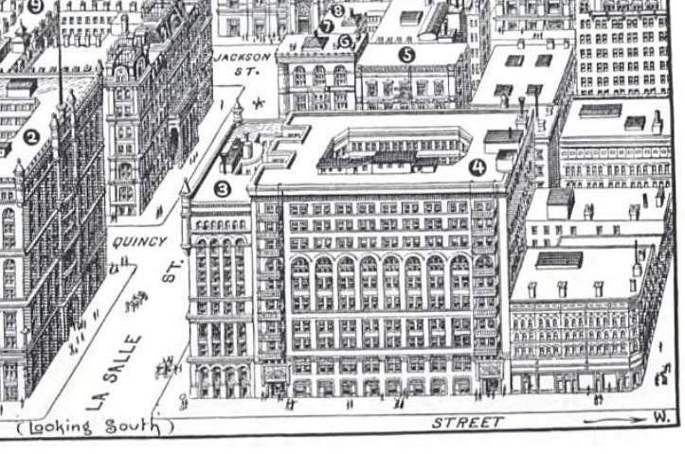
Burnham and Root Rand McNally Building Chicago 1889 Demolished 1911
STEEL
First to use Structural Steel for entire frame [1]
http://www.appstate.edu/~riedme/burnham&root/gallery.html

Slide 27
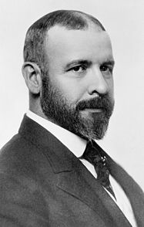
Louis Sullivan, The Father of Skyscrapers
Architect Louis Sullivan
1856-1924

Slide 28
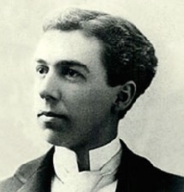
1888
At age 21, Frank Lloyd Wright approached the most famous architect in Chicago, Louis Sullivan
“I was accepted by Mr. Sullivan and went to work for Adler and Sullivan, then the only moderns in architecture, and with whom, for that reason, I wanted to work.”
Frank Lloyd Wright
Architect Louis Sullivan

Slide 29
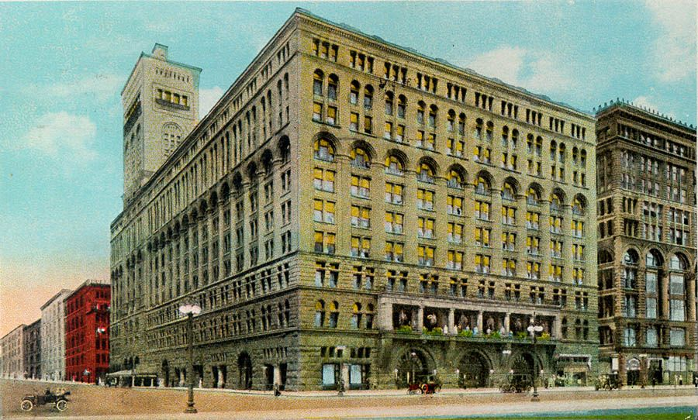
https://www.pinterest.com/pin/258745941065090364/
Auditorium Building
Chicago, 1889, Adler and Sullivan
Architect Louis Sullivan

Slide 30
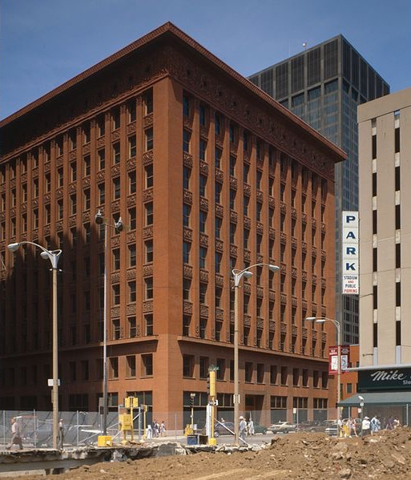
Dankmar Adler and Louis Sullivan
Wainwright Building St. Louis 1890
Frank Lloyd Wright
(a protégée of Louis Sullivan ) called this building:
"the very first human expression of a tall steel office-building as Architecture”
Building has a base, a middle section, and a top -- like a classical column [1]
Architect Louis Sullivan
http://en.wikipedia.org/wiki/Wainwright_Building

Slide 31
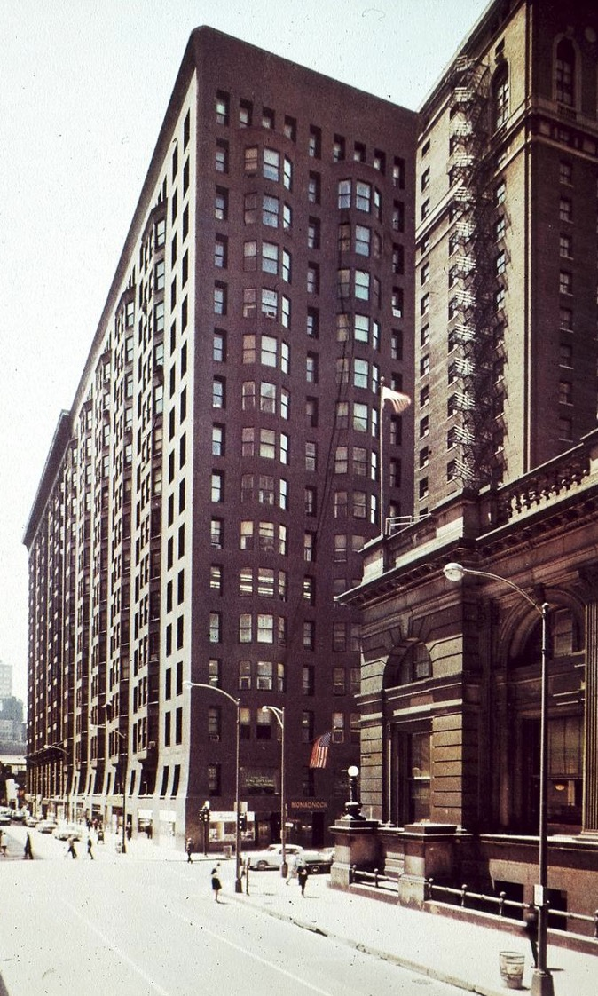
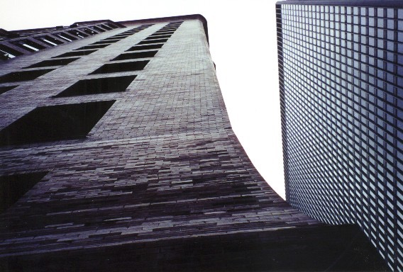
Daniel H. Burnham & John Welborn Root
Monadnock Building Chicago 1891
One of the last exterior load-bearing-masonry skyscrapers
- Walls very thick, to carry load
Also an internal iron frame for lateral
bracing of exterior walls [1]
http://www.american-architecture.info/USA/CHICAGO/CHIC-LS/018-reliance1a.gif

Slide 32
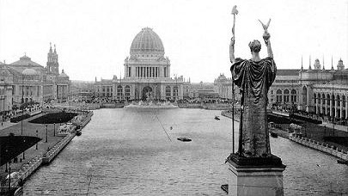
Neither Architect liked Neoclassicism (Greek or Roman)
Both annoyed by “White City” built for 1893 Worlds Fair in Chicago
Frank Lloyd Wright quoted French poet Victor Hugo:
“The setting Sun all mistook for Dawn”’
Both Architects in search of an entirely new American Architecture
“White City” built for 1893 Worlds Fair in Chicago
Frank Lloyd Wright
Architect Louis Sullivan

Slide 33
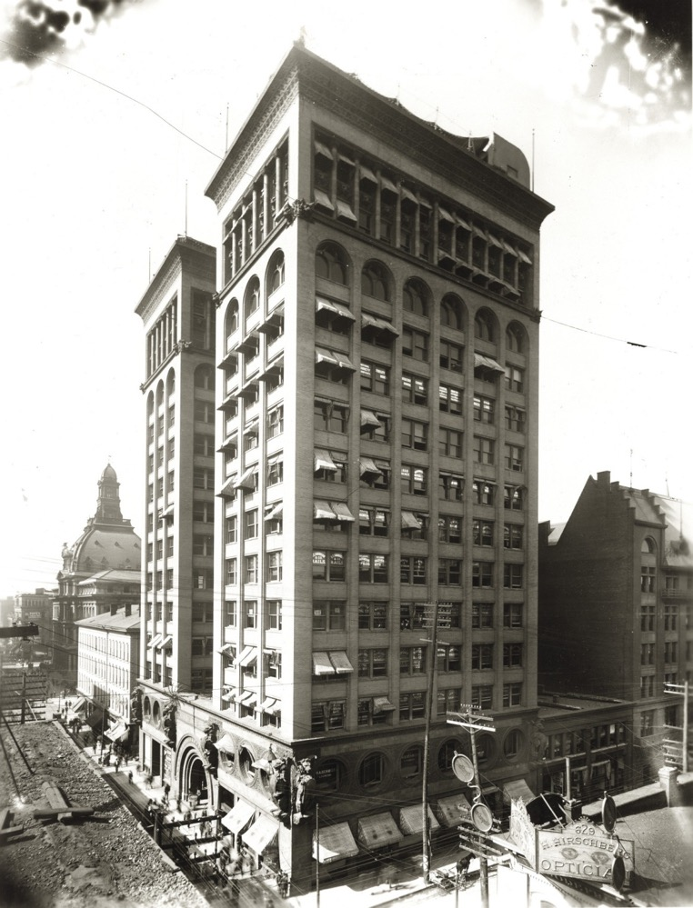
https://mohistory.org/collections/item/resource:140756
Union Trust Company Building,
St Louis, 1893, Adler and Sullivan
Architect Louis Sullivan

Slide 34
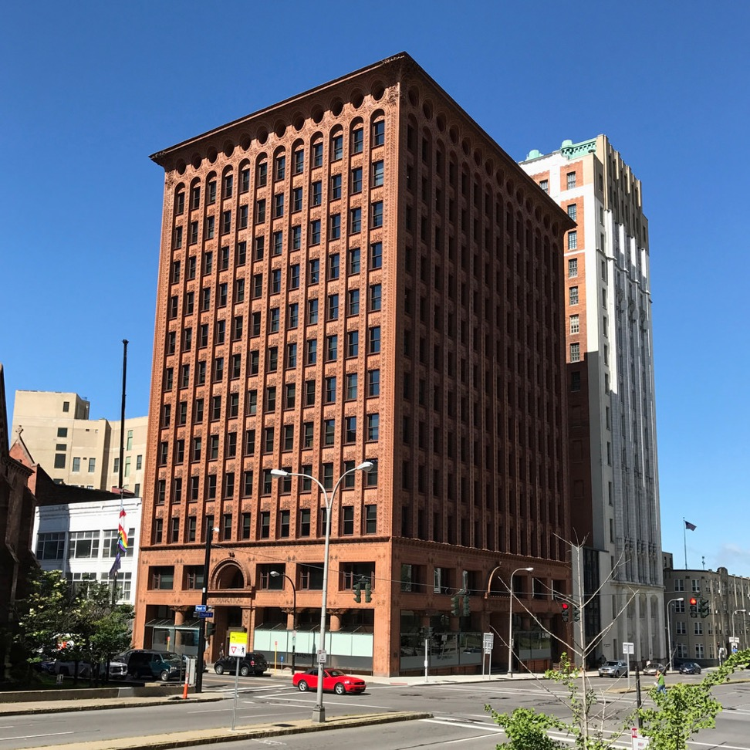
https://theplacesihavebeen.com/atlas-obscura/1554/guaranty-building
The Guaranty Building (now the Prudential Building) Buffalo, New York, 1895, Adler and Sullivan
Architect Louis Sullivan

Slide 35
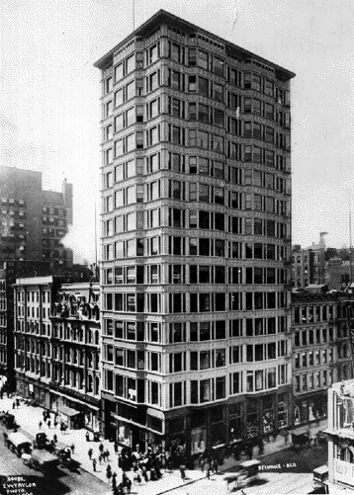
1895 STEEL & CURTAIN WALL
John Root and Charles Atwood
Reliance Building Chicago 1895
External skin of terracotta and glass clipped onto internal steel skeleton [1]
Precursor to glass curtain walls
http://www.american-architecture.info/USA/CHICAGO/CHIC-LS/018-reliance1a.gif

Slide 36
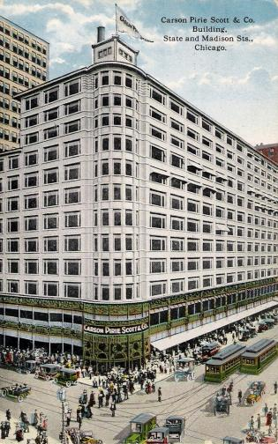
Louis Sullivan
Pirie Scott Department Store Chicago 1899
Balance of vertical and horizontal elements
Has “Chicago Windows” with large fixed panes between operable windows [1]
http://blogs.artinfo.com/objectlessons/2012/07/27/louis-sullivans-carson-pirie-scott-co-building-reopens-as-a-target-and-why-chicagoans-should-be-smiling/
Architect Louis Sullivan

Slide 37
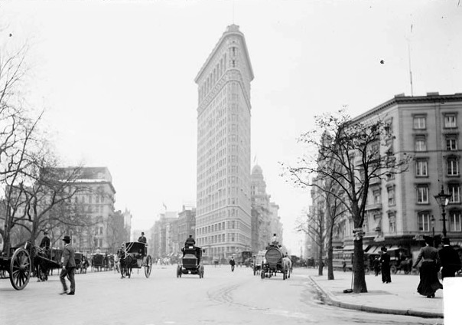
Daniel Burnham and Frederick Dinkelberg Flatiron Building New York 1902
One of the first very tall buildings
http://www.nyc-architecture.com/GRP/GRP24A.jpg

Slide 38
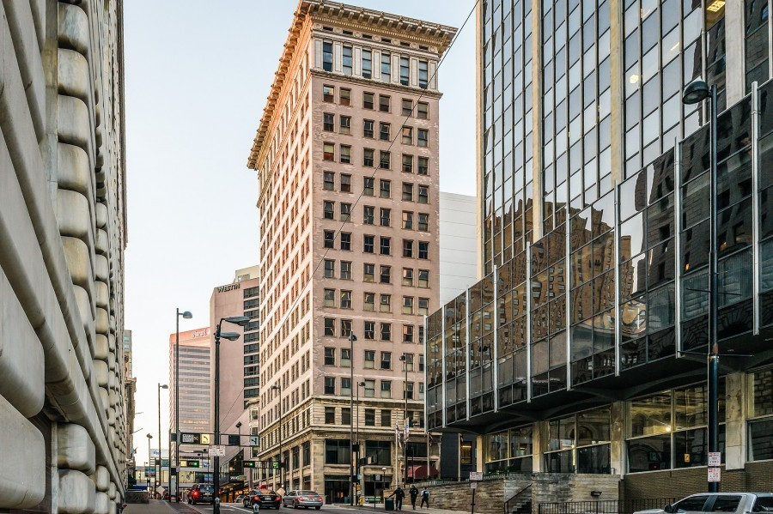
REINFORCED CONCRETE
Elzner & Anderson Ingalls Building Cincinnati 1903
A COMPOSITE MATERIAL of:
Concrete
(High Compression strength)
2. Steel Reinforcing-Bars (“Re-Bar”)
(High tensile strength)
First Reinforced Concrete Skyscraper
https://www.loopnet.com/listing/6-e-4th-st-cincinnati-oh/12158560/

Slide 39
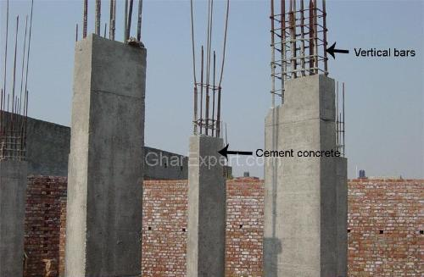
Today’s REINFORCED CONCRETE
http://www.gharexpert.com/mid/611200835306.jpg

Slide 40
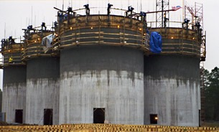
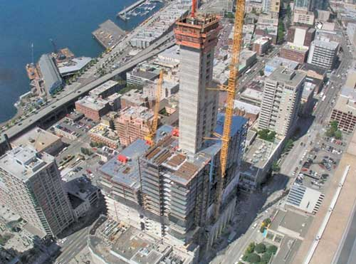
REINFORCED Concrete in more recent times
Today’s REINFORCED CONCRETE
“SLIP FORMS” allows taller buildings
http://www.wlport-land.com/images/xSlip1.jpg
http://www.structuremag.org/images/0407-f1-1.jpg

Slide 41
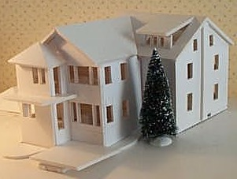
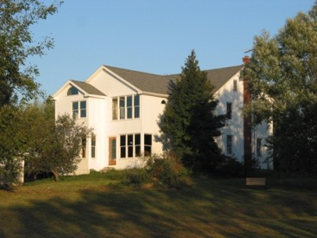
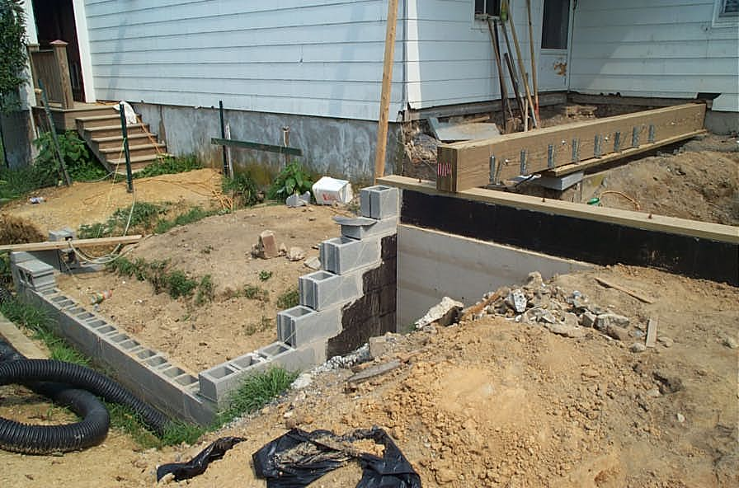
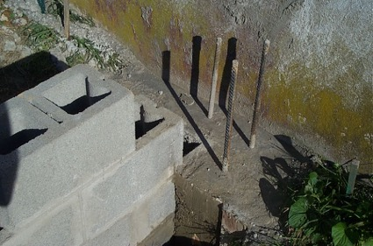
Wunderlich family project included reinforced concrete to strengthens foundation
Today’s REINFORCED CONCRETE

Slide 42
Cass Gilbert Woolworth Building New York 1913
Art Deco
Architectural Style
http://www.cassgilbertsociety.org/images/works/f/nyc-woolworth-bldg2.jpg

Slide 43
William Van Alan Chrysler Building New York 1930
Art Deco
Architectural Style
http://www.central-nyc.com/wp-content/uploads/2013/04/chrysler-building-296507.jpeg

Slide 44
William F. Lamb, Gregory Johnson Empire State Building New York 1931
Art Deco
Architectural Style
The Word’s tallest building for 40 years [1]
1933 Movie clip: https://www.youtube.com/watch?v=CuRQH_hLcTw
http://www.central-nyc.com/wp-content/uploads/2013/04/chrysler-building-296507.jpeg

Slide 45
BAHAUS SCHOOL
Germany 1919 to 1933
Founder: Architect Walter Gropius
“Modern” Architecture
The Bauhaus combined art, architecture, graphic design, interior design, industrial design, and typography. This school had influence on the Modern Architecture movement to come – in Chicago
Modern
Architectural Style
Simplicity
Minimalistic
No ornament
Harmony between
function and Design
Closed due to pressure from Nazi’s claiming it was a center of communist intellectualism
https://en.wikipedia.org/wiki/Bauhaus

Slide 46
Le Corbusier
Unité d'Habitation
Marseille, France 1945
Modern
Architectural Style
Le Corbusier
Villa Savoye
Poissy, France 1931
http://thepositive.com/sounds-and-lights-animate-the-machine-for-living/
http://www.fondationlecorbusier.fr/CorbuCache/410x480_2049_791.jpg

Slide 47
Le Corbusier - a planned city concept:
Modern
Architectural Style
http://http://www.archdaily.com/411878/ad-classics-ville-radieuse-le-corbusier

Slide 48
Ludwig Mies van der Rohe
(a Bauhaus Architect from Germany)
Seagram Building New York 1958
Modern
Architectural Style
Ludwig Mies van der Rohe
S.R. Crown Hall
Chicago 1956
Ludwig Mies van der Rohe
Farnsworth House
Plano, IL 1951
http://www.curbed.com/maps/mies-van-der-rohe-important-works
http://conservapedia.com/images/a/a6/Seagram_Building.jpg
http://conservapedia.com/images/a/a6/Seagram_Building.jpg

Slide 49
Frank Lloyd Wright
Price Tower Bartlesville, Oklahoma 1952
The origins of Sustainable Design
Wright persuaded Harold Price to build headquarters on 19 floors instead of 3 by showing how power, climate control, plumbing, and communications are simpler & more efficient via a central stack [1]
http://0.tqn.com/d/architecture/1/0/9/v/PriceTower.jpg

Slide 50
Phillip Johnson
IDS Center
Minneapolis 1968
Modern
Architectural Style
Phillip Johnson was first a Modern Architect
Phillip Johnson
Glass House
Canaan, CT 1949
http://assets.bizjournals.com/twincities/print-edition/IDS-center*304.jpg?v=1

Slide 51
Fazlur Rahman Khan, Bruce Graham Sears Tower (“Willis Tower”) Chicago 1973
Modern
Architectural Style
The Word’s tallest building for 25 years after it surpassed the Empire State Building [1]
Source: http://en.wikipedia.org/wiki/Willis_Tower

Slide 52
At it’s top, a pediment. Postmodern reminiscent of a grandfather clock, or a tall 18th century chest-of drawers
Phillip Johnson
AT&T Building, now Sony Tower
New York 1984
Postmodern
Architectural Style
POSTMODERN Architectural style - references elements prior to the Modernist movement -- in contrast to the simplicity of Modern movement [1]
http://www.achievement.org/achievers/joh0/large/joh0-050.jpg

Slide 53
At it’s base, Postmodern reminiscent of Italian renaissance architecture
Phillip Johnson
AT&T Building, now Sony Tower
New York 1984
Postmodern
Architectural Style
St. Peters Basilica in Rome 2011
http://www.constructionphotography.com/ImageThumbs/A084-00022/3/A084-00022_Sony_Plaza_tower_Manhattan_New_York_City.jpg

Slide 54
Postmodern reminiscent of Italian renaissance architecture
Phillip Johnson
Sony Tower
New York 1984
Postmodern
Architectural Style
Vatican Museum in Rome 2011
http://upload.wikimedia.org/wikipedia/commons/1/1f/Sony_Building_by_Matthew_Bisanz.jpg

Slide 55
Glass CURTAIN WALL
JT Wunderlich 1984,85 Project Manager / Designer
“West Lake Oaks” (13 buildings),
DDC Development, Austin TX
Recent CURTAIN WALL
STEEL SKELETON
Architecture , Engineering, and management of 60 contracts and several employees
Office
2018 Google Photo
Two IBM360
Computer Centers
2018 Google Photo

Slide 56
Glass CURTAIN WALL common in modern commercial buildings
Recent STEEL & CURTAIN WALL
http://img.archiexpo.com/images_ae/photo-g/stainless-steel-fixing-systems-suspended-curtain-wall-55078-1714337.jpg

Slide 57
Recent CURTAIN WALL
http://www.extal.com/userfiles/products/msg/Msg_02.jpg

Slide 58
Typical Modern Commercial Construction
Recent CURTAIN WALL
Structural Load carried by core and columns
Glass CURTAIN WALL
doesn’t carry load
This allows a SHELL to be built, followed by TENANT IMPROVEMENTS in interior
Tenants given a fixed $ per square foot, and they use a different architect (a “SPACE PLANNER”)
http://www.expresstowers.in/images/floor_plan1_1.jpg

Slide 59
JT Wunderlich 1984,85
Austin TX
Recent CURTAIN WALL
STEEL SKELETON
2018 Photo

Slide 60
JT Wunderlich 1985,86
Director of Projects / Designer
JDC Development, La Jolla, CA
Recent CURTAIN WALL
Steel and Reinforced Concrete
66,000sf hi-tech office
and light manufacturing
44,00sf office building

Slide 61
JT Wunderlich 1985,86
La Jolla, CA
Recent CURTAIN WALL
Steel and Reinforced Concrete
Led Design Team, Modified forms, Selected materials & landscaping
Project nominated for Award

Slide 62
César Pelli
Petronas Towers
Kuala Lumpur, Malaysia 1996
Postmodern
Architectural Style
http://www.orangesmile.com/extreme/en/highest-buildings/petronas-towers.htm

Slide 63
C.Y. Lee & Partners
Taipei 101
Taipei, Taiwan 2004
Postmodern
Architectural Style
http://www.lonelyplanet.com/taiwan/taipei/sights/architecture/taipei-101

Slide 64
Norman Foster
The Gherkin
London, 2004
Neo-Futuristic
Architectural Style
http://www.luxuryestate.com/blog/wp-content/uploads/2014/09/copertina3-720x408.jpg

Slide 65
Rem Koolhaas, Ole Scheeren
CCTV Headquarters
Beijing, China 2008
Deconstructive
Architectural Style
http://www.skyscrapercity.com/showthread.php?t=179084

Slide 66
Frank Gehry
Spruce St. Tower
New York 2011
Deconstructive
Architectural Style
https://www.flickr.com/photos/bostoncitywalk/6657472251
https://www.pinterest.com/pin/279997301807926908/

Slide 67
Adrian Smith, Marshall Strabala,
George J. Efstathiou, William F. Baker
Burj Khalifa
Dubai, United Arab Emirates 2014
Neo-Futuristic
Architectural Style
World’s
Tallest Building
http://en.wikipedia.org/wiki/File:Burj_dubai_aerial_closeup.jpg

Slide 68
Burj Khalifa 2014
Neo-Futuristic
Architectural Style
http://highrisefacilities.com/wp-content/uploads/2013/12/Skyscraper-History-Chart.jpg

Slide 69
Burj Khalifa 2014
Neo-Futuristic
Architectural Style
http://upload.wikimedia.org/wikipedia/commons/thumb/0/06/Burj_Khalifa_floors.svg/512px-Burj_Khalifa_floors.svg.png

Slide 70
Burj Khalifa 2014
Neo-Futuristic
Architectural Style
Video:
http://www.skymetweather.com/content/earth-and-nature/must-watch-natures-lightning-show-over-burj-khalifa/
http://upload.wikimedia.org/wikipedia/commons/thumb/0/06/Burj_Khalifa_floors.svg/512px-Burj_Khalifa_floors.svg.png

Slide 71
Marshall Strabala, Jun Xia
Shanghai Tower
Shanghai, China 2015
Sustainable Design
Artist’s rendition
http://www.evolo.us/wp-content/uploads/2010/07/twisting-tower-shanghai.jpg
https://en.wikipedia.org/wiki/Shanghai_Tower

Slide 72
Shanghai Tower 2015
Sustainable Design
URBAN DESIGN
http://images.autodesk.com/flashassets/thegallery/galleries/shanghai_tower/1.analysis/images/Shanghai_Tower_Analysis_2.jpg

Slide 73
Shanghai Tower 2015
Sustainable Design
CONCEPTUAL DESIGN
http://images.autodesk.com/flashassets/thegallery/galleries/shanghai_tower/3.taper/images/Shanghai_Tower_Taper_1.jpg

Slide 74
Shanghai Tower 2015
Sustainable Design
CONCEPTUAL DESIGN
http://www.gensleron.com/storage/post-images/WineyPost1Image1.jpg

Slide 75
Shanghai Tower 2015
Sustainable Design
CONCEPTUAL DESIGN
http://www.vmspace.com/uploads/magazine/512/r1.jpg

Slide 76
Shanghai Tower 2015
Sustainable Design
Huge glass curtain walls hung from upper decks
Image From:http://www.anotherpartofme.com/wp-content/uploads/2013/05/shanghai_tower03.jpg

Slide 77
Shanghai Tower 2015
Sustainable Design
http://sites.psu.edu/khalqubbaj/wp-content/uploads/sites/4598/2013/09/ShanghaiTower_8_v2.jp g

Slide 78
Sustainable Design
Shanghai Tower 2015
Huge glass curtain walls hung from upper decks
http://assets.inhabitat.com/wp-content/blogs.dir/1/files/2011/12/Shanghai-tower-6.jpg

Slide 79
Shanghai Tower 2015
Sustainable Design
Double outer walls allows for internal open spaces
http://www.china-sbs.com/userfiles/26.jpg

Slide 80
Shanghai Tower 2015
Sustainable Design
Glass façade reduces wind loads by 24%. Therefore 25% less structural steel saves US$58 million
Construction practices optimized
Vertical-axis wind turbines at top generate 350,000 kWh of electricity per year
Double-layered insulating glass façade reduces need for air conditioning
Heating &cooling use geothermal energy
Rain water collection
Source: http://assets.inhabitat.com/wp-content/blogs.dir/1/files/2011/12/shanghai-tower-bim.jpg

Slide 81
Shanghai Tower 2015
Sustainable Design
Image From:http://4.bp.blogspot.com/-UGNergNxHYA/UCPj3Bp2gDI/AAAAAAAAHQk/KaEbJhj_qH8/s1600/Shanghai_Tower_worlds_tallest_skyscrapers_Blueprints_Structural_Models_and_floor_plans_by_Gensler_world_of_architecture_worldofarchi_08.jpg

Slide 82
Shanghai Tower 2015
Sustainable Design
Has a concrete core, and structural steel.
Not tallest building, but doesn’t aspire to be – it’s something completely new
A
VERTICAL GREEN CITY
http://www.e-architect.co.uk/images/jpgs/shanghai/shanghai-tower-g070813-3.jpg
:

Slide 83
Shanghai Tower 2015
Sustainable Design
However,
We hopefully won’t rely entirely on artificial interior worlds – no matter how well we can make them “Sustainable”
http://www.e-architect.co.uk/images/jpgs/shanghai/shanghai-tower-g070813-3.jpg
:
https://en.wikipedia.org/wiki/Shanghai_Tower

Slide 84
STRUCTURAL STEEL
“Wide-Flange” steel beam or column (sometimes called an “I beam”, but not by Engineers or most Architects) helped allow taller buildings
Great:
Flexural Strength
Compression Strength
Shear Strength
Tensile Strength
http://www.architectionary.com/uploads/WideFlangeSection/wshape.jpg

Slide 85
STRUCTURAL STEEL FABRICATION

Slide 86
STRUCTURAL STEEL FABRICATION
MOLTEN IRON
ROLLING MILL (forming a Wide-Flange)

Slide 87
STRUCTURAL STEEL FABRICATION
ROLLING MILL (cutting a Wide-Flange)
INSPECTING Wide-Flange Beams/Columns

Slide 88
STRUCTURAL STEEL
SHAPES

Slide 89
STRUCTURAL STEEL
SHAPES

Slide 90
STEEL STRUCTURAL ENGINEERING

Slide 91
STEEL STRUCTURAL ENGINEERING

Slide 92
STEEL STRUCTURAL ENGINEERING
SKIM THROUGH STEEL DESIGN MANUAL (WHAT STRUCTURAL ENGINEERS USE):
https://www.aisc.org/publications/steel-construction-manual-resources/
DESIGN EXAMPLES:
https://www.aisc.org/globalassets/aisc/manual/v15.1-companion/v15.1_vol-1_design-examples.pdf

Slide 93
Watch structural Steel Beam design video:
https://youtu.be/AUwxAFCnAZw
STEEL STRUCTURAL ENGINEERING

Slide 94
STEEL FRAME STRUCTURES
Can melt, so fire safety coatings developed (in Chicago after great fire of 1874)
Can handle large LATERAL LOADS
wind
seismic (earthquake) forces
in one of two ways:
“BRACED-FRAME” Diagonal braces OR “MOMENT CONNECTION”
STEEL STRUCTURAL ENGINEERING
http://www.graitec.com/en/images/products/ad_bracings_01.jpg
http://www.graitec.com/en/images/products/ad_bracings_01.jpg

Slide 95
BRACED-FRAME
Cheaper
STEEL STRUCTURAL ENGINEERING
MOMENT CONNECTION
(“MOMENT” = “TORQUE”)
Unobstructed views
Simpler interiors
http://www.ashleyvance.com/projects/commercial/soma-renovation-and-seismic-upgrade
http://www.graitec.com/en/images/products/ad_bracings_01.jpg
http://www.stlsi.com/images/DSC01209.JPG
http://programas.cype.es/imagen/nuevoMetal3D/union_I_soldada_49.gif
https://d2t1xqejof9utc.cloudfront.net/screenshots/pics/a97c97f0e72c8856c002117a53f2bb1b/medium.jpg
http://buildipedia.com/images/masterformat/Channels/On_Site/Technical_Lessons_Learned/Steel_Connection.jpg

Slide 96
STEEL STRUCTURAL ENGINEERING
BRACED-FRAME
MOMENT CONNECTION
http://www.featurepics.com/FI/Thumb300/20070505/Highrise-Construction-306455.jpg
http://jiano.typepad.com/photos/uncategorized/brb_02.jpg

Slide 97
STEEL STRUCTURAL ENGINEERING
CONNECTIONS (RIVET)

Slide 98
STEEL STRUCTURAL ENGINEERING
CONNECTIONS (BOLT)

Slide 99
STEEL STRUCTURAL ENGINEERING
CONNECTIONS (WELD)

Slide 100
STEEL STRUCTURAL ENGINEERING
CONNECTIONS
(BOLT, WELD)
SHEAR connection
MOMENT connection
A MOMENT connection can handle a Moment (torque) at connection

Slide 101
STEEL STRUCTURAL ENGINEERING

Slide 102
STEEL STRUCTURAL ENGINEERING

Slide 103
BAR JOIST
STEEL STRUCTURAL ENGINEERING
BAR JOIST
BAR JOIST

Slide 104
ROOF TRUSS
STEEL STRUCTURAL ENGINEERING

Slide 105
ROOF TRUSS
STEEL STRUCTURAL ENGINEERING

Slide 106
STEEL STRUCTURAL ENGINEERING
COLUMN

Slide 107
STEEL STRUCTURAL ENGINEERING
CORREGATED DECK

Slide 108
STEEL STRUCTURAL ENGINEERING
Heat (FIRE)
1 Kip = 1000 Pounds

Slide 109
STEEL STRUCTURAL ENGINEERING
Heat (FIRE)

Slide 110
STRUCTURAL ENGINEERING
STEEL vs. Wood vs. Brick vs. Concrete

Slide 111
STEEL STRUCTURAL ENGINEERING

Slide 112
INTERIOR STRUCTURES and corresponding building heights
http://sydney.edu.au/architecture/documents/publications/ASR/Structural%20Developments%20in%20Tall%20Buildings.pdf

Slide 113
EXTERIOR STRUCTURES and corresponding building heights
http://sydney.edu.au/architecture/documents/publications/ASR/Structural%20Developments%20in%20Tall%20Buildings.pdf

Slide 114
STEEL
STUDS
for
COMMERCIAL CONSTRUCTION
For INTERIOR PARTITIONS
And typically not “Load Bearing”

Slide 115
STEEL
STUDS
for
COMMERCIAL CONSTRUCTION

Slide 116
STEEL
STUDS
for
COMMERCIAL CONSTRUCTION

Slide 117
Skyscrapers can be part of quality URBAN DESIGN
where buildings compliment each other,
and their surroundings

Slide 118
Austin Texas in early 1980’s
- U Texas BS Architectural Engineering
with many classes on the upper floors of high-rises
- Then worked for Developers
https://nexstarnetwork.com/what-we-do/events/super-meeting/san-diego-skyline/
https://www.pinterest.com/pin/186195765819905266/

Slide 119
Recent Austin skyline
https://nexstarnetwork.com/what-we-do/events/super-meeting/san-diego-skyline/
https://www.pinterest.com/pin/186195765819905266/

Slide 120
San Diego 1980’s: Office in hi-rise working for developers (in addition to office in La Jolla), then worked for Planning Commission while in 2nd degree UCSD program in Urban Design
https://nexstarnetwork.com/what-we-do/events/super-meeting/san-diego-skyline/

Slide 121
San Francisco in late 1980’s …. Frequent meetings in downtown San Francisco skyscraper , and lived in the city, while working for an A&E firm, and starting grad school in Physics (to lead to M.Eng and PhD in Hi-Tech, then IBM Research, Purdue Professor, Elizabethtown Professor)
https://nexstarnetwork.com/what-we-do/events/super-meeting/san-diego-skyline/

